Slide 1
Diseases of the Buccal Cavity and Associated Organs
By
Dr. Hussein AlNaji

Slide 2
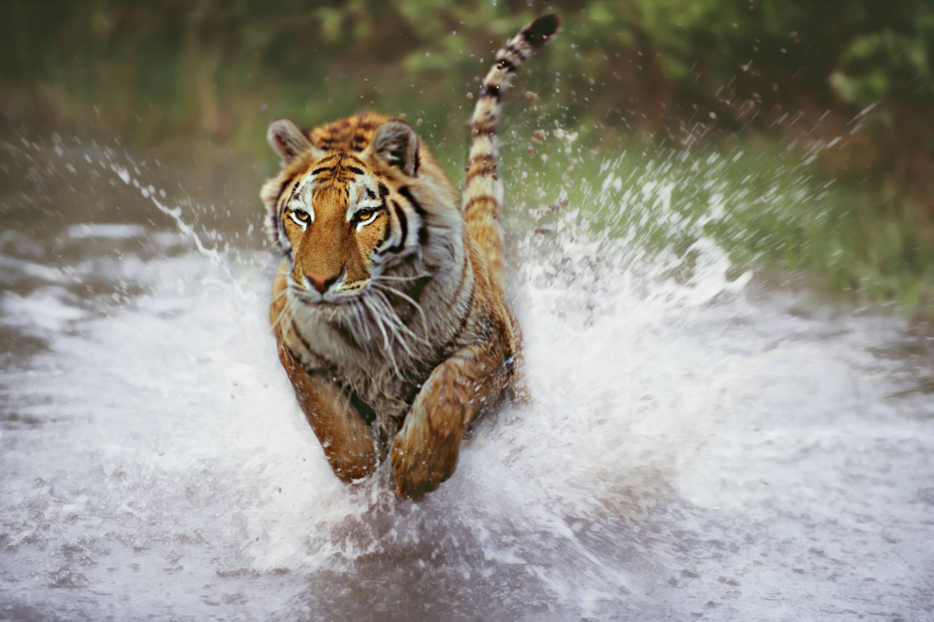
DISEASES OF THE MUZZLE
Severe dermatitis with scab formation, development of fissures, and sloughing and gangrene of the skin of the muzzle are common lesions in cattle affected with
Photosensitive dermatitis.
Bovine malignant catarrh.
Bovine virus diarrhea.
Rinderpest.
In bluetongue and sheep severe lesions of the muzzle are less common, but occur in ecthyma.

Slide 3
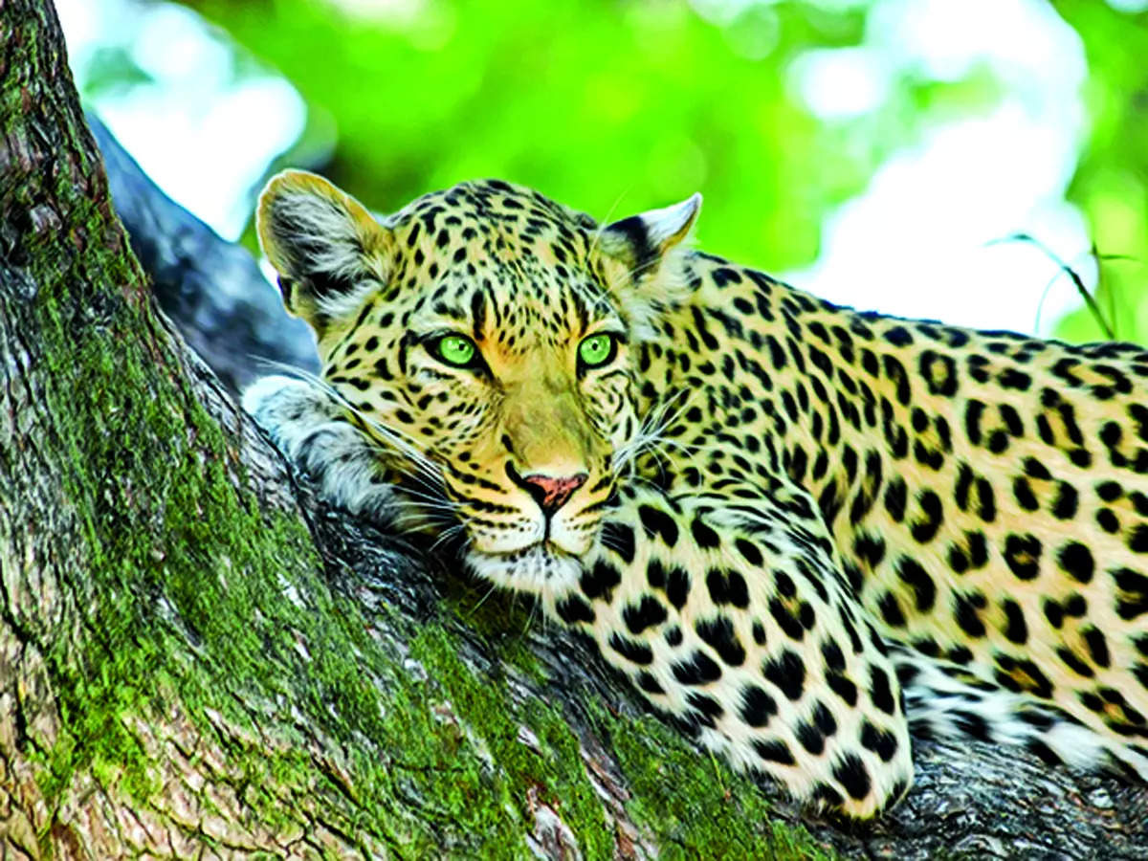
STOMATITIS
Stomatitis is inflammation of the oral mucosa and includes glossitis (inflammation of the tongue), palatitis (lampas; inflammation of the palate), and gingivitis (inflammation of the mucosa of the gums). Clinically it is characterized by
partial or complete loss of appetite.
Smacking of the lips
Profuse salivation.

Slide 4
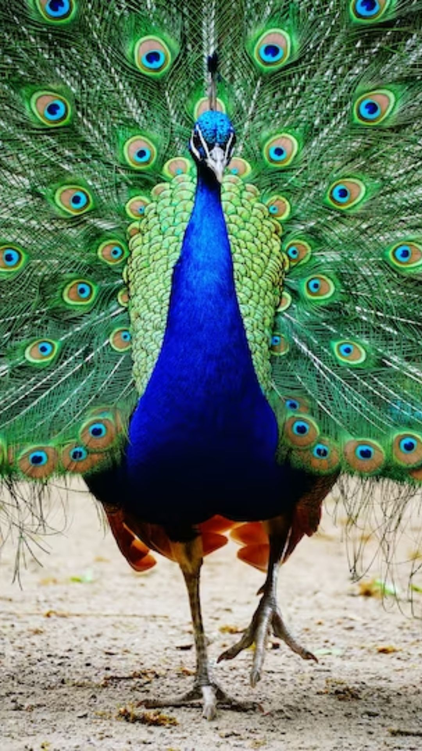
ETIOLOGY
Stomatitis can be caused by physical, chemical, or infectious agents, with the last being the largest group of causes. The agents are listed next.
Physical Agents
Trauma while dosing orally with a balling gun or similar instruments.
Laceration of the tongue. 3. Foreign body injury.
4. Malocclusion of teeth. 5. Sharp awns or spines on plants.
6. Eating frozen feed and drinking hot water are recorded.

Slide 5

B. Chemical Agents
Irritant drugs, e.g., chloral hydrate, administered in excessive concentrations.
Counterirritants applied to skin, left unprotected, and licked by the animal, including mercury and cantharides compounds.
Irritant substances administered by mistake, including acids, alkalis, and phenolic compounds.
Manifestation of systemic poisoning, e.g., chronic mercury poisoning.

Slide 6
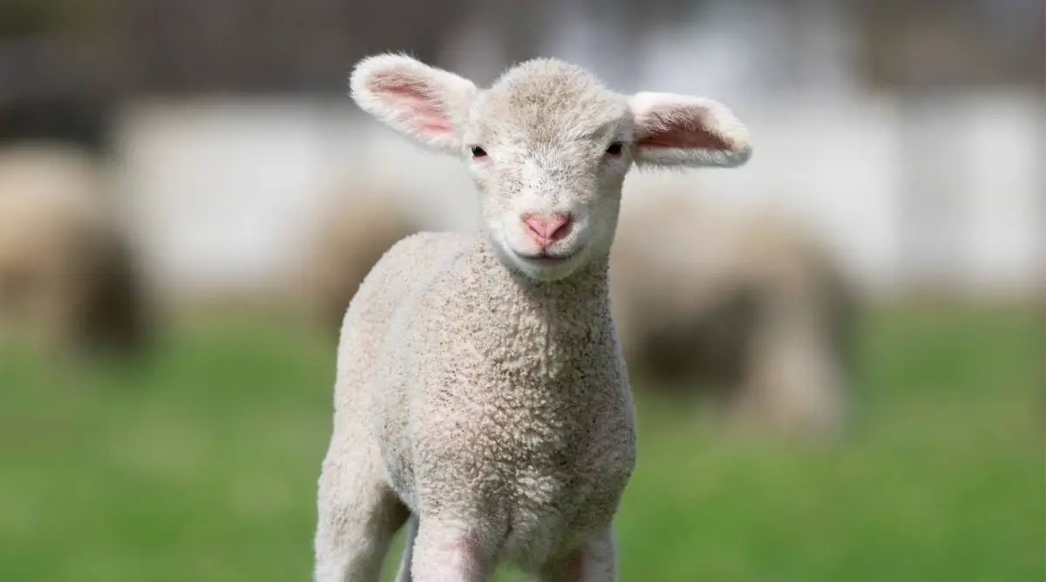
C. Infectious Agents
Cattle and Sheep
Oral necrobacillosis associated with Fusobacterium necrophorum.
Actinobacillosis of the bovine tongue.
Ulcerative, granulomatous lesions may occur on the gums in cases of actinomycosis.
Stomatitis with vesicles occurs in FMD and in vesicular stomatitis (VS).

Slide 7
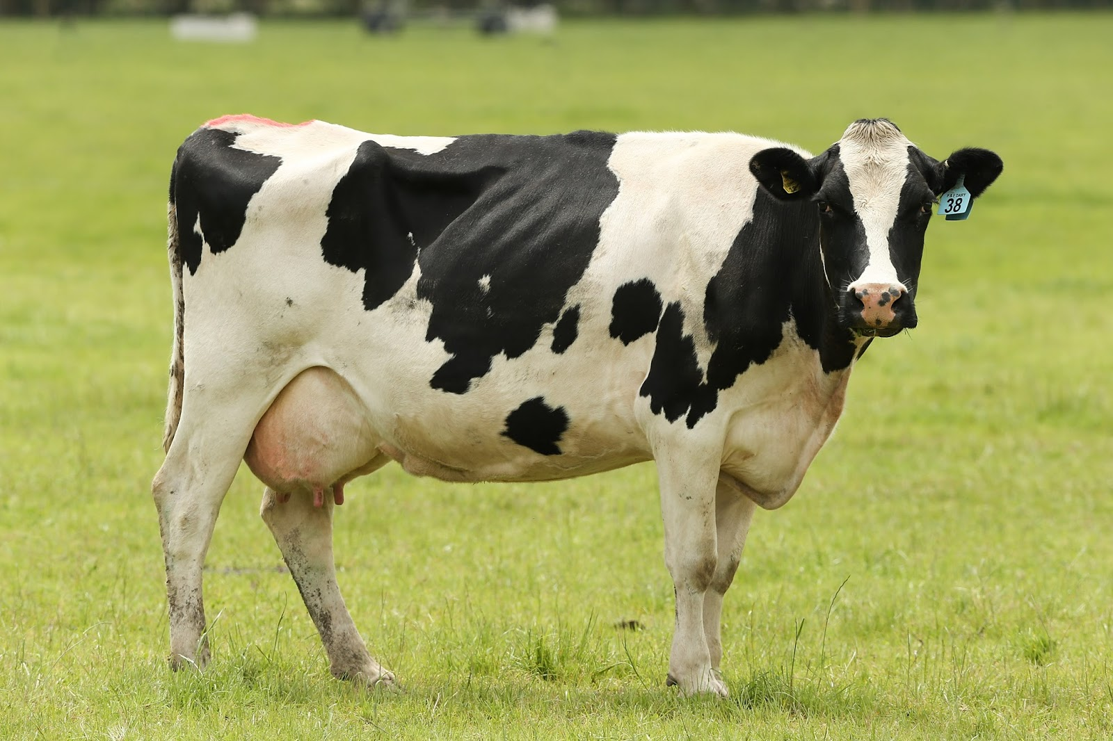
5. Erosive, with some secondary ulcerative, stomatitis occurs in bovine viral diarrhea (mucosal disease), bovine malignant catarrh, rinderpest. and rarely in bluetongue. Cases of infectious bovine rhinotracheitis in young calves may have similar lesions.
6. Proliferative lesions occur in popular stomatitis, proliferative stomatitis, and rare cases of rhinosporidiosis and papillomatosis where the oral mucosa is invaded.
7. Oral mucosal necrosis in bovine sweating sickness.

Slide 8
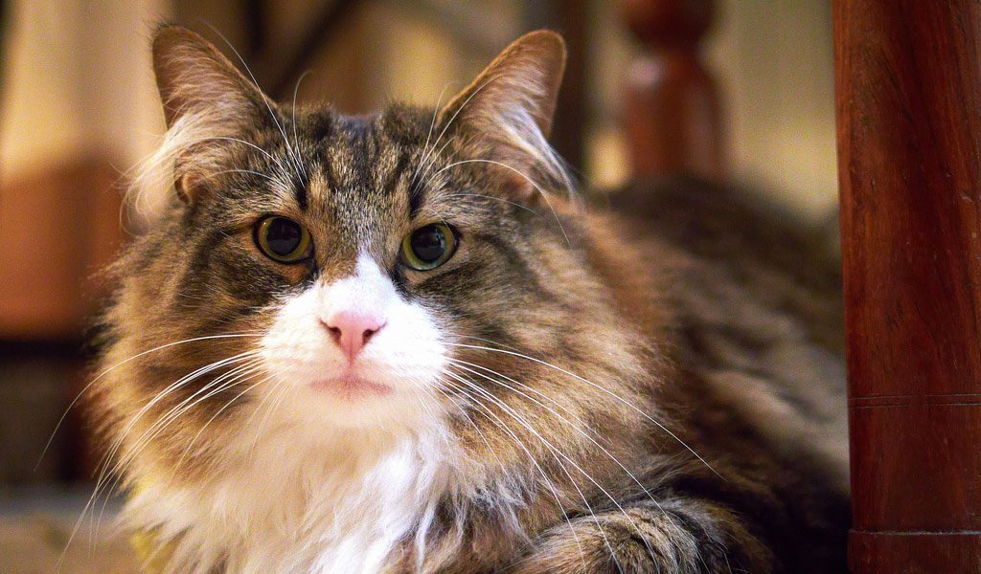
CLINICAL FINDINGS
There is partial or complete anorexia and slow and painful mastication.
Chewing movements and smacking of the lips are accompanied by salivation, either frothy and in small amounts, or profuse and drooling if the animal does not swallow normally.
The saliva may contain pus or shreds of epithelial tissue.
A fetid odor is present on the breath only if bacterial invasion of the lesion has occurred.

Slide 9
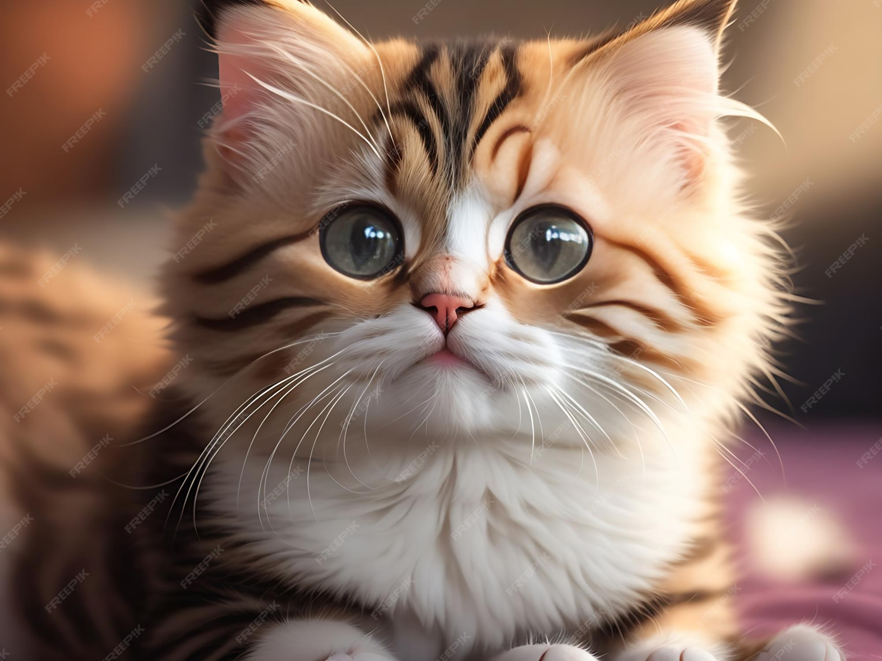
5. Enlargement of local lymph nodes may also occur if bacteria invade the lesions.
6. Swelling of the face is observed only in cases where a cellulitis or phlegmon has extended to involve the soft tissues.
7. An increased desire for water is apparent and the animal resents manipulation and examination of the mouth.
8. Toxemia may be present when the stomatitis is secondary to a systemic disease or where tissue necrosis occurs.

Slide 10

Several different lesions of the oral cavity may be present and their characteristic appearances are as follows
Erosions are shallow, usually discrete, areas of necrosis, which are not readily seen in the early stages.
Vesicles are thin-walled swellings 1 to 2 cm in diameter filled with clear serous fluid. They are very painful and rupture readily to leave sharp-edged, shallow ulcers.
Ulcerative lesions penetrate more deeply to the lamina propria and are painful.

Slide 11

4. Traumatic lesions are usually solitary and characterized by a discontinuity in the mucous membrane often with evidence of healing and the presence of granulation tissue.
5. Catarrhal stomatitis is manifested by a diffuse inflammation of the buccal mucosa and is commonly the result of direct injury by chemical or physical agents.
6. Mycotic stomatitis is characterized by a heavy, white velvety deposit with little obvious inflammation or damage to the mucosa.
7. Laceration of the tongue can result in complete or partial severance of the organ, with the severed portion protruding from the oral cavity.

Slide 12

TREATMENT
Affected animals should be isolated and fed and watered from separate utensils if an infectious agent is suspected.
Nonspecific treatment includes frequent application of a mild antiseptic collutory such as a 2% solution of copper sulfate, a 2% suspension of borax, or a 1% suspension of a sulfonamide in glycerin.
Indolent ulcers require more vigorous treatment and respond well to curettage or cauterization with a silver nitrate stick or tincture of iodine.

Slide 13


